Slide 1
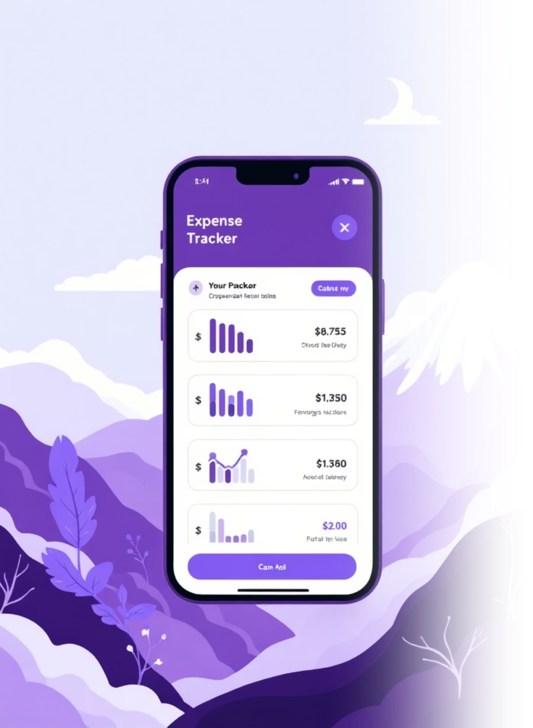
SpendSmart – Personal Finance & Expense Tracker
Smartly manage your expenses, effortlessly.

Slide 2
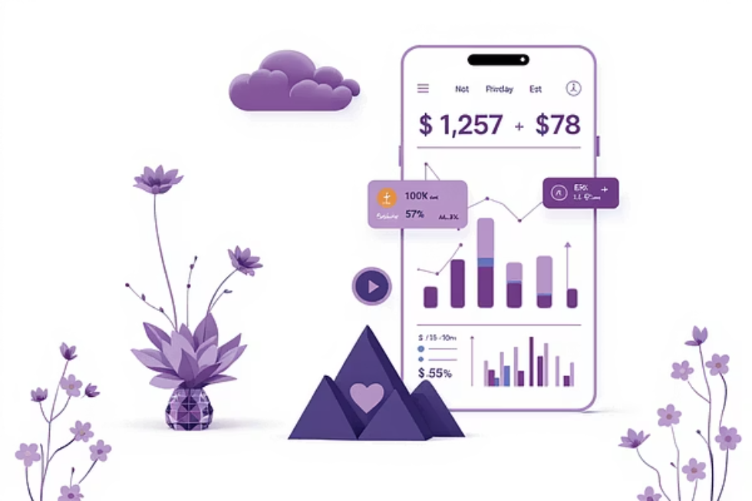
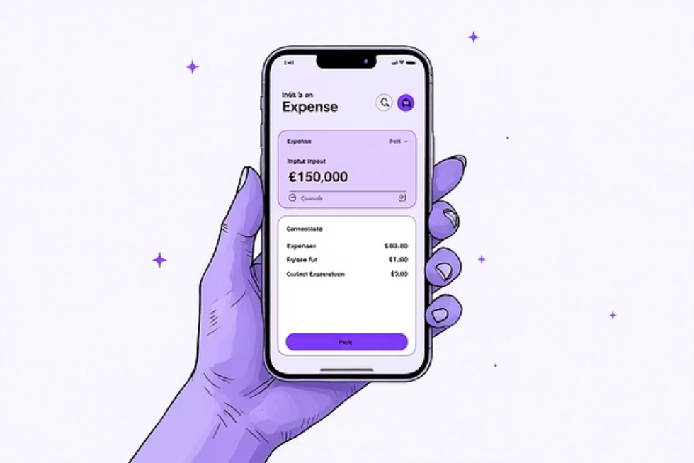
PROJECT OVERVIEW
Revolutionising Personal Finance Management
The SpendSmart Vision
Key Project Goals
SpendSmart was designed to bridge the gap between complex financial tools and daily expense tracking. Our goal was to create an intuitive, AI-powered assistant that makes managing money simple and insightful for the everyday user.
Enhance user awareness of spending habits.
Simplify the expense logging process to seconds.
Provide actionable insights and savings recommendations.
Create a clean, non-intimidating UX.

Slide 3

Problem and Solution: From Confusion to Clarity
The Challenge: User Pain Points
The Solution: SpendSmart's Approach
Manual & Tedious Tracking
Effortless Categorisation
Users rely on spreadsheets or manual entries, making tracking inconsistent and frustrating.
Quick entry templates and intelligent categorization powered by machine learning for simple tracking.
Lack of Insight
Existing apps often show data but fail to translate it into actionable financial advice or budgeting tips.
Visual Data Analytics
Intuitive charts and clear visualisations that immediately highlight spending trends and anomalies.
Budget Overruns
Poor awareness of real-time spending leads to frequently exceeding budget limits and financial stress.
Proactive Reminders
Real-time notifications and friendly reminders to keep users within their defined financial boundaries.

Slide 4




Target Audience
Young Professionals
Financially Minded Beginners
Establishing financial independence, managing debt, and starting to save seriously.
Individuals new to budgeting who need guidance, education, and simple visual feedback.
Families & Households
The Core User
Need to track shared expenses, manage varying income streams, and plan for future large purchases.
Tech-savvy, values time, seeks clear data visualization, and wants actionable steps toward financial wellness.

Slide 5





Design Thinking Process
We followed a five-stage iterative process to ensure the final product was deeply rooted in user needs and thoroughly validated.
Empathise
Understanding the user, their needs, and financial pain points through research and interviews.
Define
Clearly articulating the problem statement and key user needs based on gathered insights.
Ideate
Brainstorming diverse solutions and features to address the defined problems effectively.
Design
Creating low to high-fidelity mockups for core features and user flows.
Test
Gathering user feedback on prototypes and iterating on the design until optimal usability is achieved.

Slide 6
EMPATHISE
User Research
Qualitative Research
In-depth interviews revealed critical frustrations with current methods of financial tracking and management. Here are some of the questions asked during these interviews:
How do you currently track your income and expenses?
What methods have you tried in the past to manage your finances, and what was your experience with them?
What are the biggest challenges you face when trying to keep track of your spending?
How often do you review your financial activity?
What information would you like to see to better understand where your money goes?
Do you set financial goals? If so, how do you track your progress towards them?
What frustrates you most about existing budgeting or financial tracking apps?
What features would make financial management feel less like a chore?
How do you feel when you discover unexpected expenses or overspending?
What would a "perfect" financial tracking tool look like for you?

Slide 7
EMPATHISE STAGE
Competitor Analysis: Identifying Gaps
We analysed leading expense tracking apps to pinpoint feature shortcomings and areas where SpendSmart could offer a differentiated experience.
Features
Walnut
Money Manager
Spendee
Spend Smart
Automatic Sync/SMS Reading
Yes
Limited
Yes
Seamless & Secure
Visual Analytics & Reporting
Moderate
Basic
Moderate
Advanced & Actionable
UX Simplicity
Cluttered
Functional
Good
Minimalist & Intuitive
Goal-Based Savings Guidance
No
No
Basic
Integrated Goal Setting
The core missing element was the integration of simple UX with powerful, actionable insights. Most apps either prioritised complexity or overly basic functionality.

Slide 8
EMPATHISE STAGE
SWOT Analysis for Product Strategy
Assessing internal and external factors helped define our strategic positioning in a competitive market.
S
W
Strengths
Weaknesses
Intuitive interface and fast expense entry
Initial low brand recognition
Strong focus on data privacy
Reliance on third-party bank integration APIs
O
T
Opportunities
Threats
Expand into investment tracking features
Rapid evolution of FinTech competitors
Target B2B expense management market
Changing financial regulations and compliance issues

Slide 9



DEFINE
User Persona: Meet Wanda, The Prudent Professional
Goals
Save ₹20,000 per month consistently.
Track all expenses automatically without manual input.
Understand where her money is truly going.
Frustrations
Manual logging is too tedious and forgettable.
Monthly spending reports are often too late to take corrective action.
Complex budgeting terms feel intimidating.
“I just want a simple way to see if I can afford that weekend trip without stressing about my budget.”
Wanda , 28
Job: Marketing Analyst (Avengers team)
Location: New York
Bio: Wanda is ambitious and enjoys city life, but she wants to be financially responsible. She often loses track of small daily expenses like coffee and cab fares, making her end-of-month saving goal unreachable.

Slide 10
Empathy Mapping
Says
Does
I wish I could clearly see where my money goes each month.
Tracks spending manually in notes or Excel.
Checks bank balance frequently.
Budgeting feels hard when expenses are unplanned.
Searches online for expense management tips.
I want reminders for bills and savings goals.
Uses UPI and e-wallets regularly.
Thinks
Feels
Wonders how much she could save if she reduced small daily expenses.
Feels anxious when unplanned bills appear.
Feels motivated when she sees savings grow.
Thinks financial tracking apps are too complex.
Feels guilty after impulse purchases.
Considers setting up an emergency fund but doesn't know where to start.

Slide 11
IDEATE
User Flow
Visualizing how users move through key actions in the SpendSmart app — from tracking expenses to viewing insights.
Splash screen
On boarding
Sign up
Login
Profile
Budget
Expenses
Savings
Insights
Edit profile
Create budget
Daily expense
Savings goal
Spending chart
Account link
Income source
Categories
Smart saving
MonthlyReport
App theme
Spend limits
AI tracker
Track progress
AI ChatBox

Slide 12
IDEATE
Information Architecture
Structuring the SpendSmart app's screens and navigation for a seamless user experience.
Welcome screen
Forget Password
Login
Sign up
Reset Password
Create Account
Google Account
Home Screen

Slide 13
Home screen
Dashboard
Transactions
Budgets
Statistics
Monthly spending
Spending history
Budget history
Spending Money
Expenses insights
Categories
Saving goals
Money spent
Spending categories
Spending insights
Track budget
Spent categories
Create budget
Enter details
Categories
Set limits
Budget alert

Slide 14
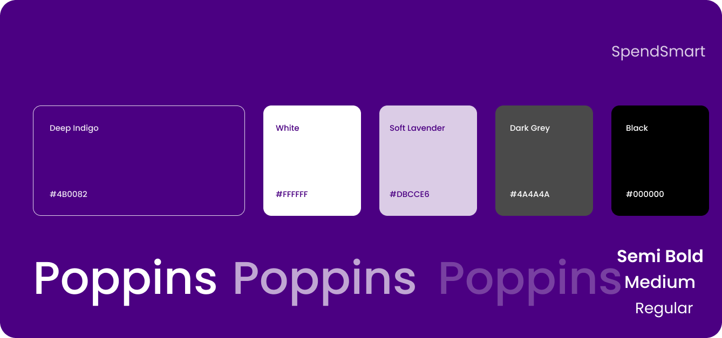
Colors and Typography
For SpendSmart, I chose a deep indigo to symbolize intelligence and reliability, complemented by clean white, soft lavender, and subtle greys for a balanced, modern interface. I use the Poppins font family for its clarity and versatility, with bold weights for headings and regular weights for body text. This combination creates a professional, trustworthy, and visually refined experience.

Slide 15
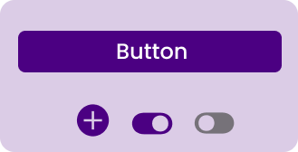
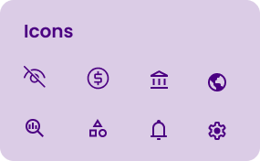
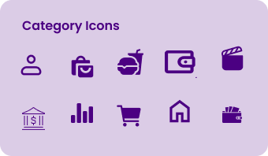
Design System
SpendSmart’s category icons follow a consistent design language — rounded, minimal, and easy to recognise — ensuring clarity in visual hierarchy and quick user navigation across spending categories.

Slide 16
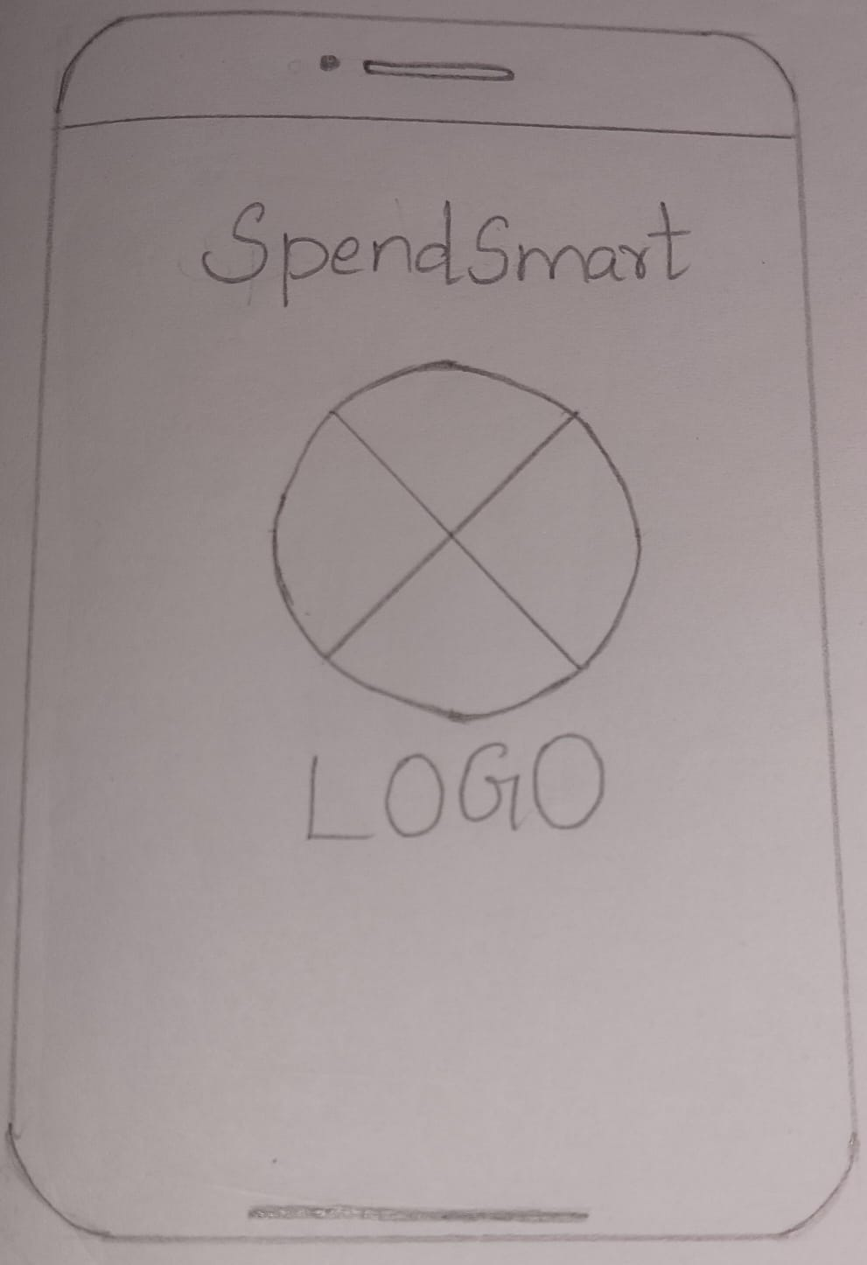
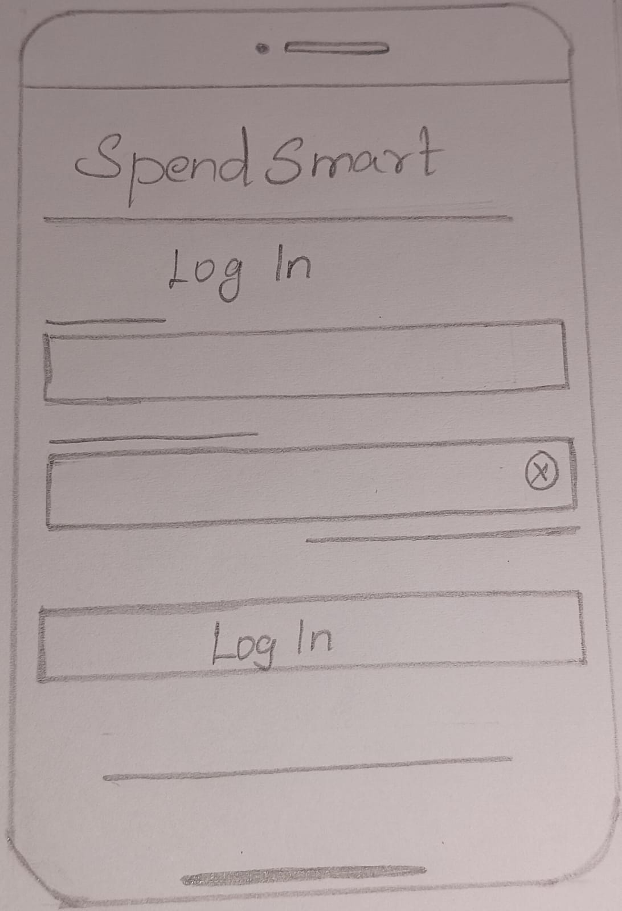
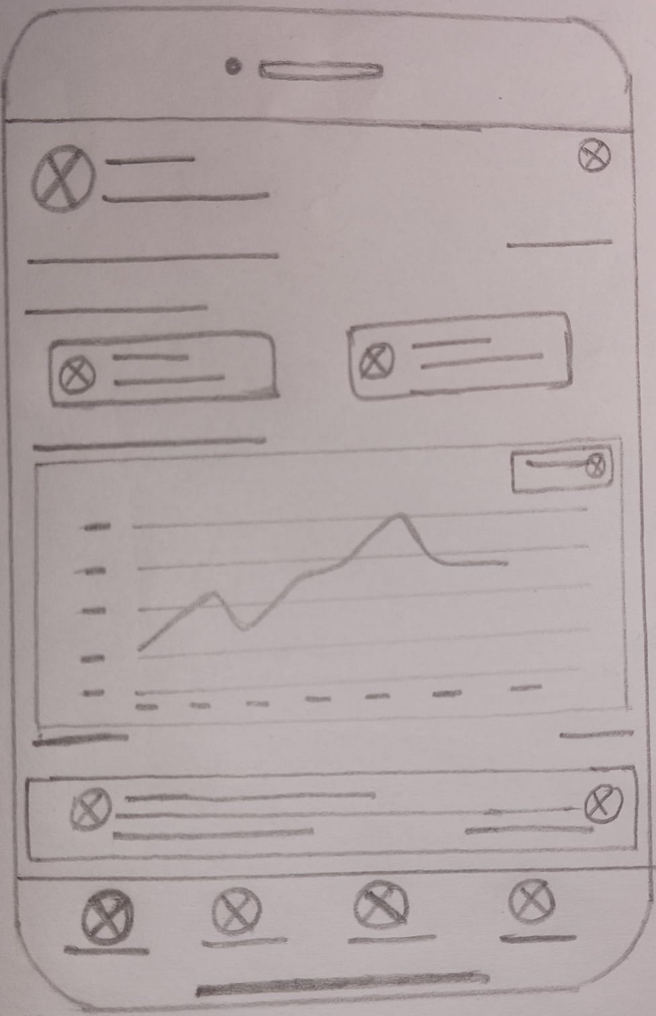
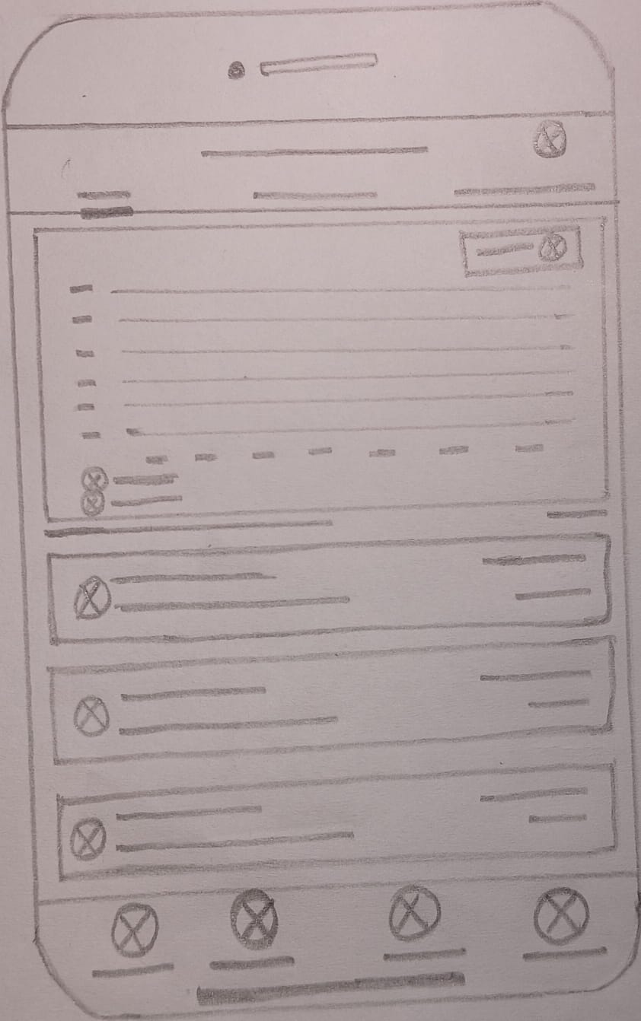
DESIGN
Low Fidelity Wireframes
Low-fidelity wireframes for SpendSmart represent the initial visualization of the app’s structure and user flow. They focus on the basic layout, placement of key elements, and overall navigation without detailed design or styling. These wireframes help define the core functionality and ensure that the app’s information architecture and interactions align with user needs. They serve as an essential foundation before progressing to mid-fidelity wireframes.

Slide 17
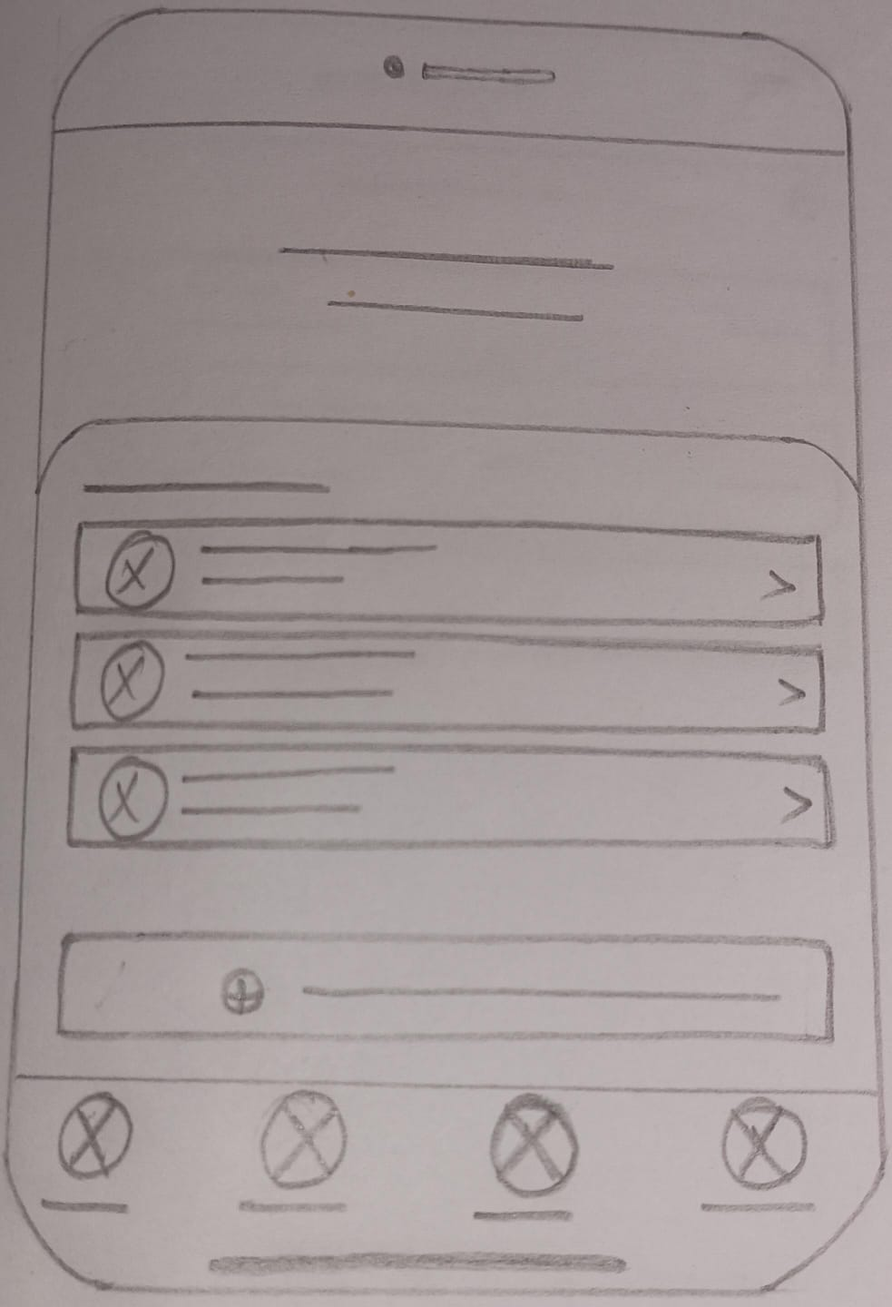
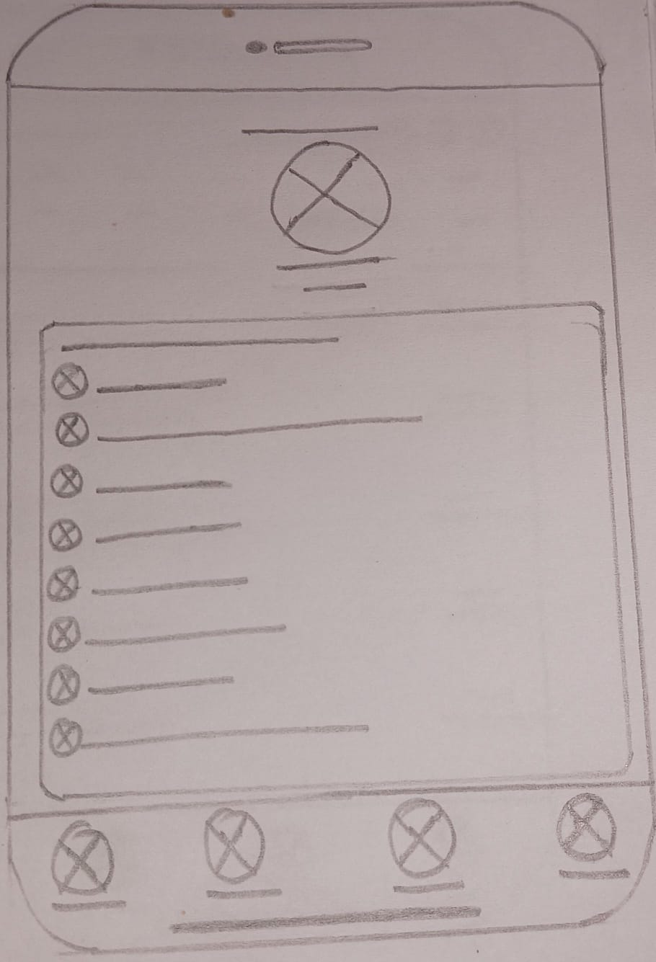
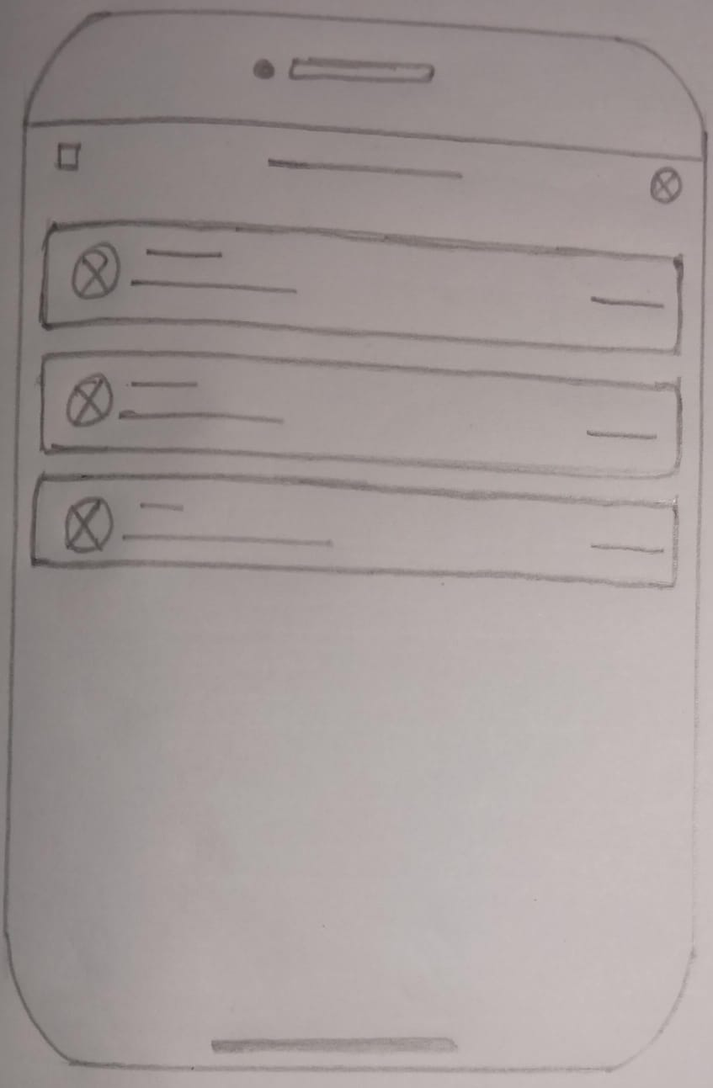
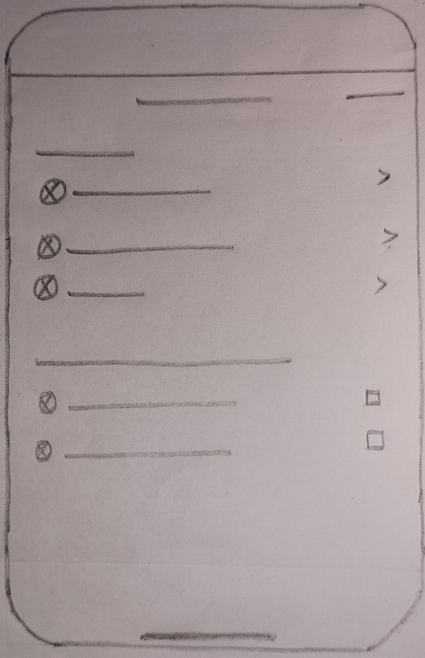
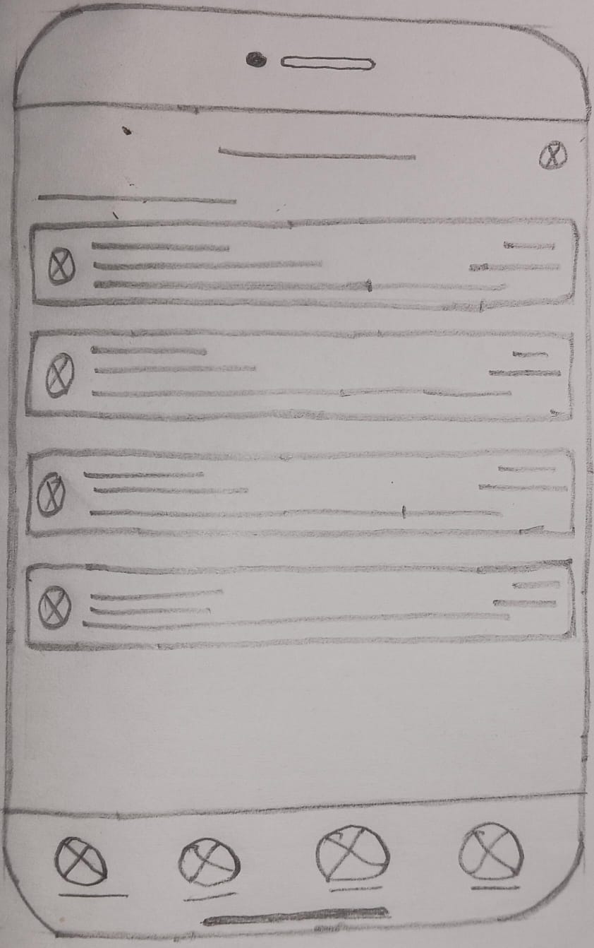
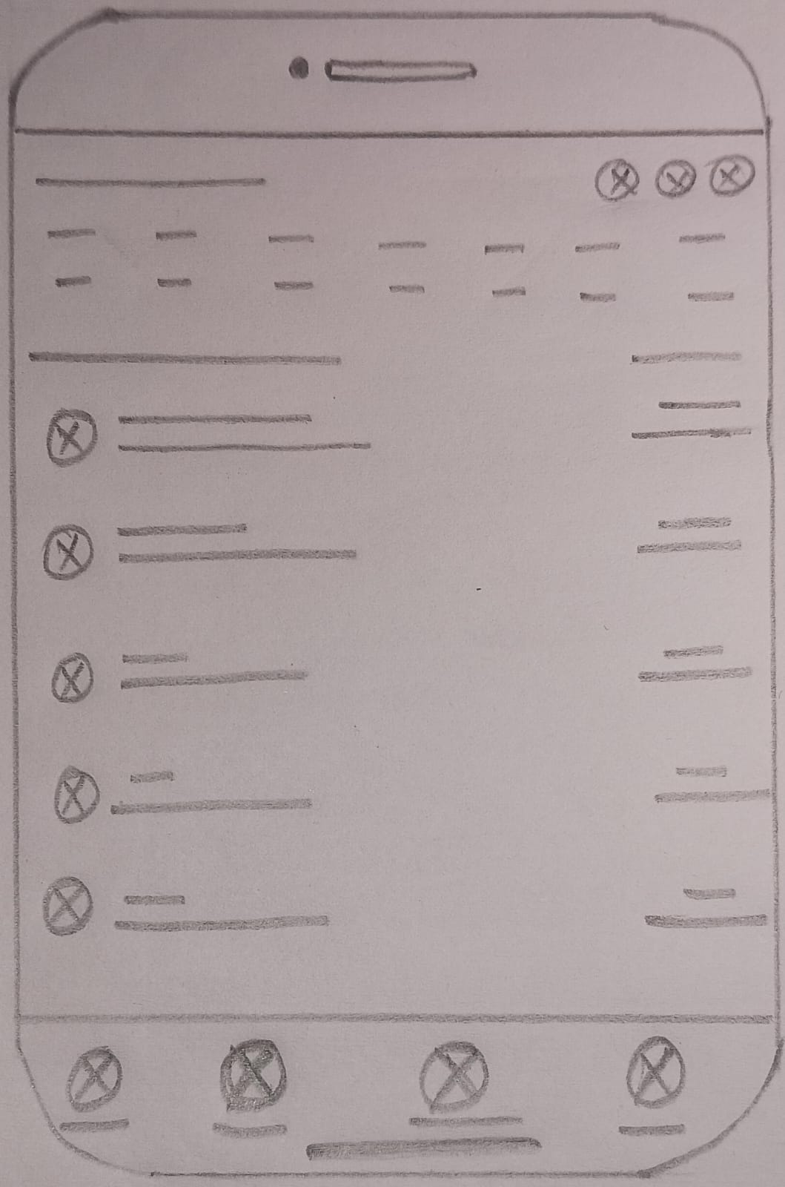

Slide 18
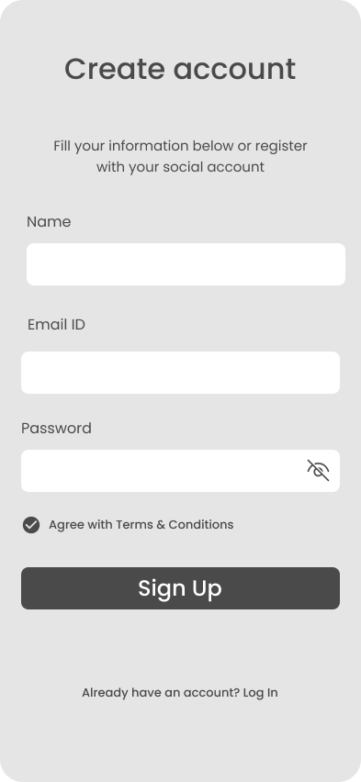
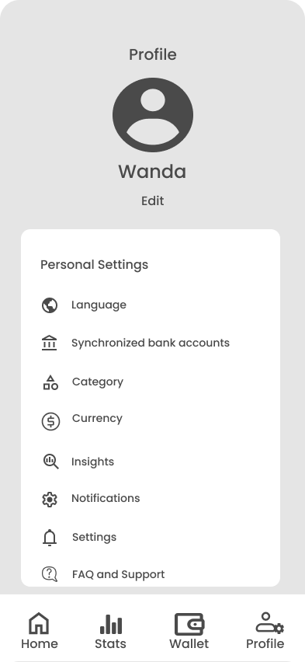
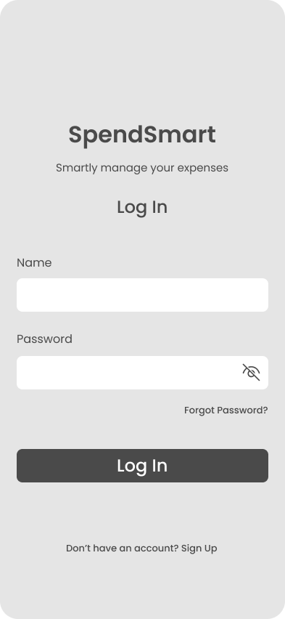
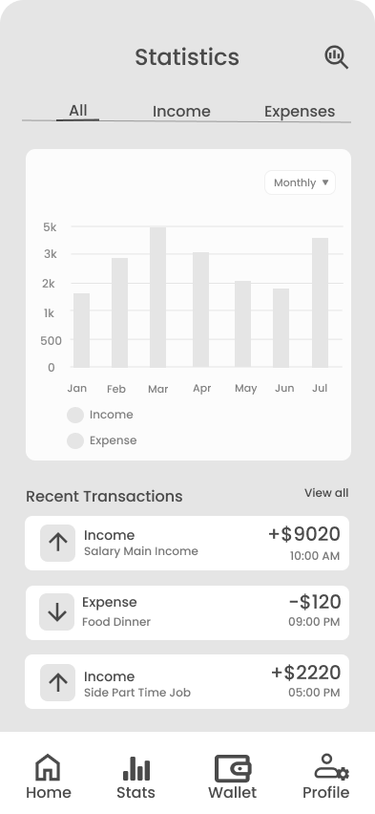
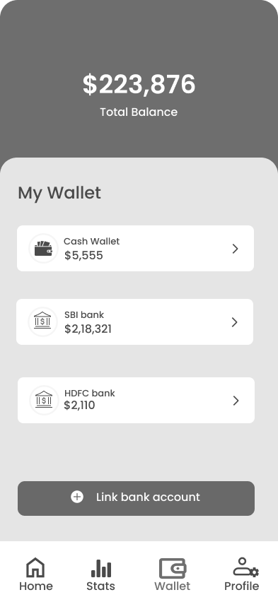
DESIGN
Mid Fidelity Wireframes
Mid-fidelity wireframes for SpendSmart outline the app’s core functionality and layout, providing a clear visual representation of the user interface. These wireframes focus on structure and usability without detailed design elements. They serve as a crucial step in refining the app’s user experience before moving to high-fidelity prototypes.

Slide 19
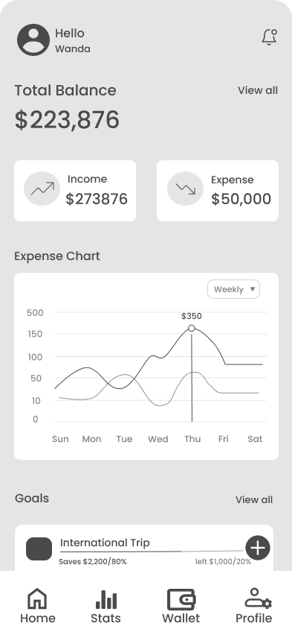
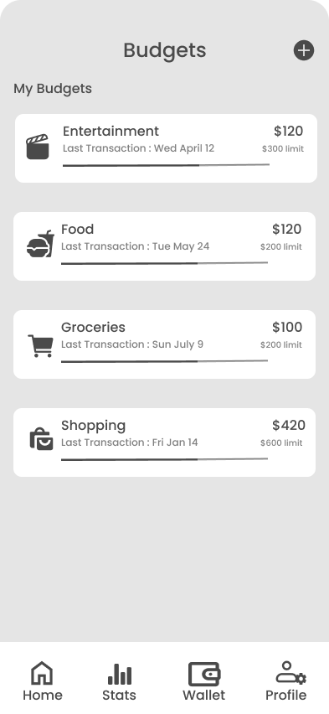
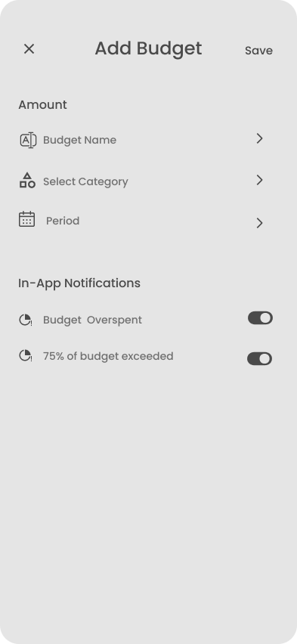
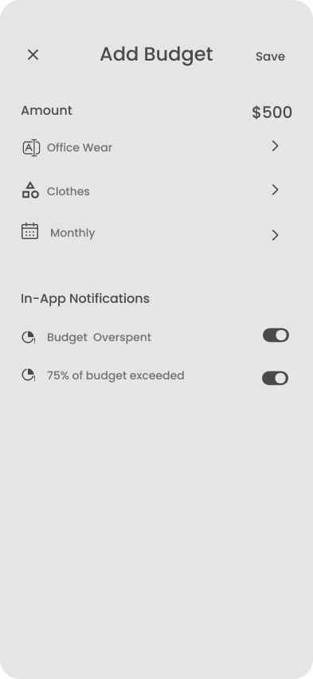

Slide 20
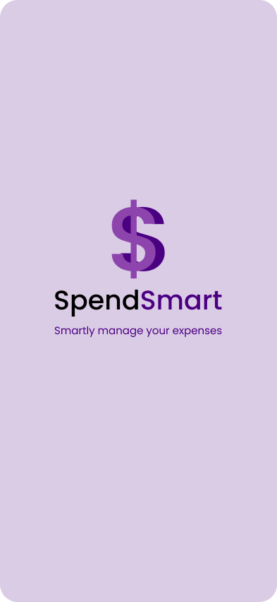
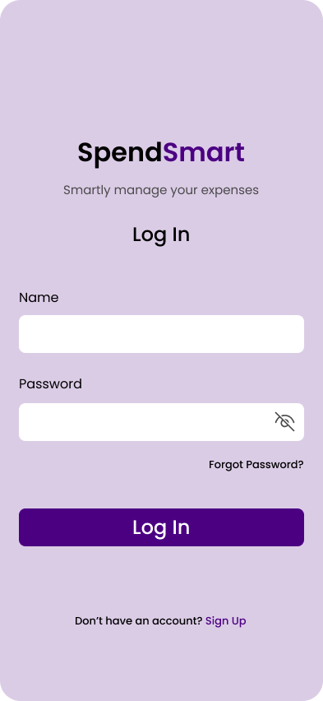
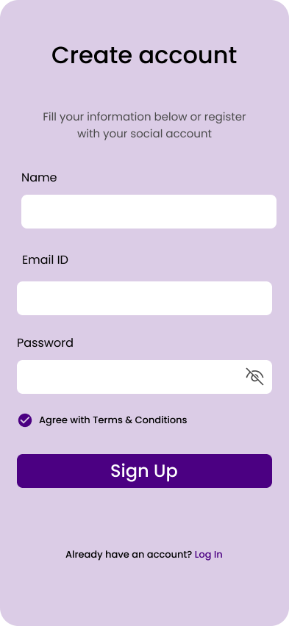
DESIGN
High Fidelity Wireframes
High-fidelity wireframes for SpendSmart bring the final design vision to life, showcasing refined visuals, colour palette, typography, and interactive elements. They represent the completed user interface and highlight the app’s usability and visual consistency.
Splash & Log In Screens

Slide 21
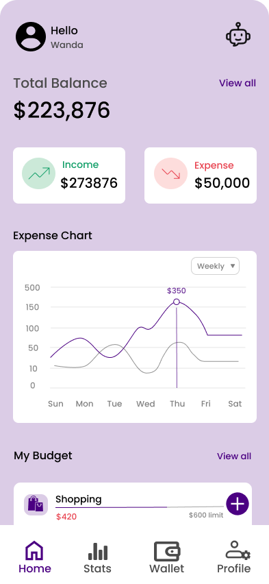
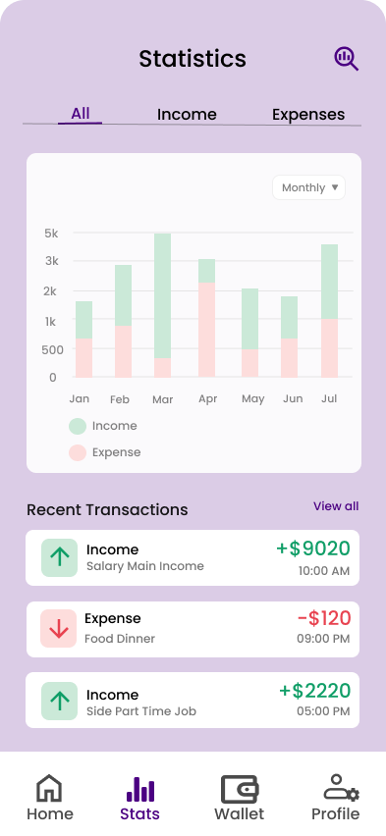
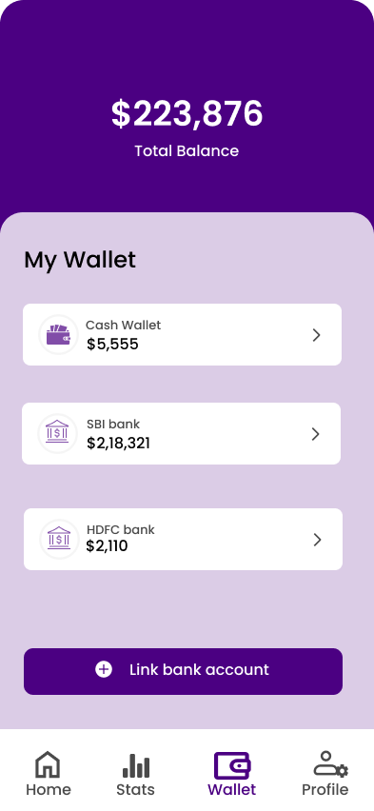
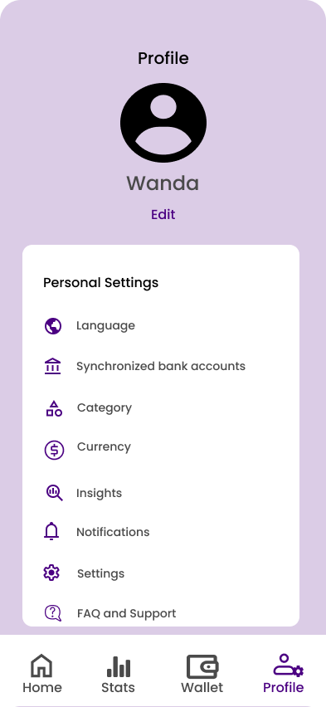
Main Screens
Home Screen --------
------Income & Expense Statistics
Displays an overview of your financial status and recent activities.
The income and expense statistics screens provide users with clear, graphical representations of their financial data.
Wallet Screen --------
------Profile Settings
The wallet screens in SpendSmart offer users a comprehensive view of their finances.
The profile screen offers a range of features to customize and manage your account

Slide 22
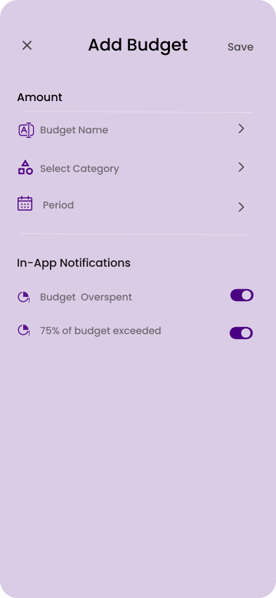
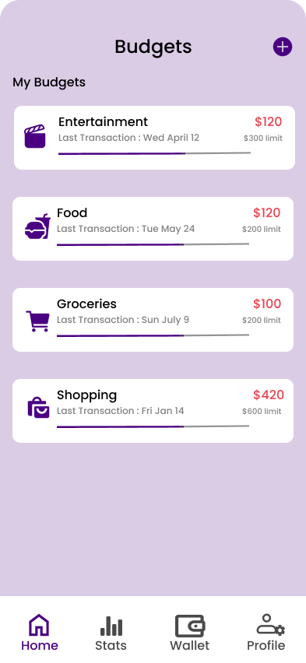
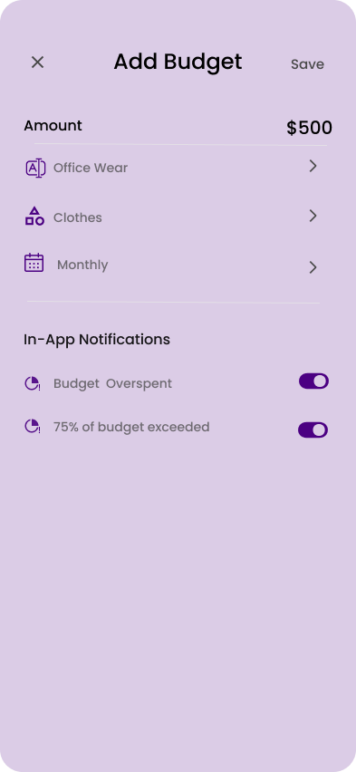
Flow 1 : Add Budget
Add Budget
|
|
|
|
|
Budget Screen
Add Amount ,Name
|
|
|
|
|
|
|
|
|
|
Helps users plan and manage their spending within specified limits.

Slide 23
TEST
Feedback
Users found the app easy to navigate and visually clear.
The color scheme and icons were appreciated for simplicity.
Expense tracking flow felt smooth and quick to complete.
Area to Improve:
Some users suggested adding clearer category labels for faster understanding.

